Slide 1
Optimizing Data Transfer in Hospitals using Li-Fi Technology
Presented by Hamna Mughal

Slide 2

AGENDA
1. Introduction
Introduction
Motivation
Problem Statement
2. Literature Review
3. System Modeling
Proposed Block Diagram
4. Hardware Implementation
Mathematical Modeling
Hardware Diagram
Performance Analysis
5. Results & Discussion
6. Conclusion
Applications of Projects
Future Work
Benefit to Society
UN Goals

Slide 3
INTRODUCTION
1.
High Demand for Efficient Data Transfer
Hospital require rapid and reliable data transfer for patient records, medical imaging, and real-time patient monitoring.
2.
Traditional Wireless Technologies
Like Wi-Fi, face limitation in terms of bandwidth, interference, and security.
3.
Introducing Li-Fi in Healthcare Settings
Wide Bandwidth
Interference free communication
Enhanced Security
Telemedicine and Interdepartmental Communication
Latency
Scalability Issues
Li-Fi, or Light Fidelity, is a wireless communication technology that uses light to transmit data.
The concept of Li-Fi was introduced by Harald Haas in 2011, highlighting its potential as a complementary technology to Wi-Fi.
Li-Fi transmits data by modulating light intensity in a rapid manner, allowing information to be conveyed in binary format using 0s and 1s.
This technology offers high-speed data transfer and can be used in various environments, including homes, offices, and public spaces, where light sources are already present.

Slide 4
Problem Statement
Motivation
High Data Transfer Speeds
Enhanced Security
Energy Efficiency
Reliability
Cost Effective
Sometimes, Wi-Fi struggles with reliability when sending medical data, leading to delays in critical healthcare decisions.
Wi-Fi's data rate may not always be sufficient for the increasing volume of medical information, making quick access to patient records challenging.
Patient privacy is at risk with Wi-Fi due to security concerns, as it may not always provide adequate protection for sensitive data.

Slide 5
LITERATURE REVIEW
Area of Focus | Title | Issues
Communication model designing | Mana, Sreelal Maravanchery, et al. "LiFi experiments in a hospital." Optical Fiber Communication Conference. Optica Publishing Group, 2020. | limited Signal range, physical obstacle susceptibility.
 | Nugraha, Toha Ardi, and Yudhi Ardiyanto. "Li-Fi technology for transmitting data in hospital environments." 2020 1st International Conference on Information Technology, Advanced Mechanical and Electrical Engineering (ICITAMEE). IEEE, 2020. | Signal range problems and potential limitations
 | Lorenz, Pascal, and Louiza Hamada. "LiFi Towards 5G: Concepts Challenges Applications in Telemedecine." 2020 Second International Conference on Embedded & Distributed Systems (EDiS). IEEE, 2020. | Potential interoperability and scalability issues
Integration of various sensors. | Gatti, Ravi, et al. "Implementation of Health Monitoring System for Patients using Li-Fi Technology." 2021 International Conference on Recent Trends on Electronics, Information, Communication & Technology (RTEICT). IEEE, 2021. | challenges in upholding security protocols, especially with regard to the privacy
 | Sarkar, Manash, et al. "An Intelligent Health Diagnosis System Based on a Secure Data Transfer Through Li-Fi Technology." New Trends and Applications in Internet of Things (IoT) and Big Data Analytics. Cham: Springer International Publishing, 2022. 149-171. | possible difficulties in coexisting with network scalability.
 | Elmangosh, Nailal, Ibrahim Ighneiwa, and Ibtihal Fawzi ElShami. "The Impact of Li-Fi Technology on Industrial Wireless Sensors Networks." 2022 International Conference on Engineering & MIS (ICEMIS). IEEE, 2022. | possible difficulties in coexisting with other wireless technologies

Slide 6
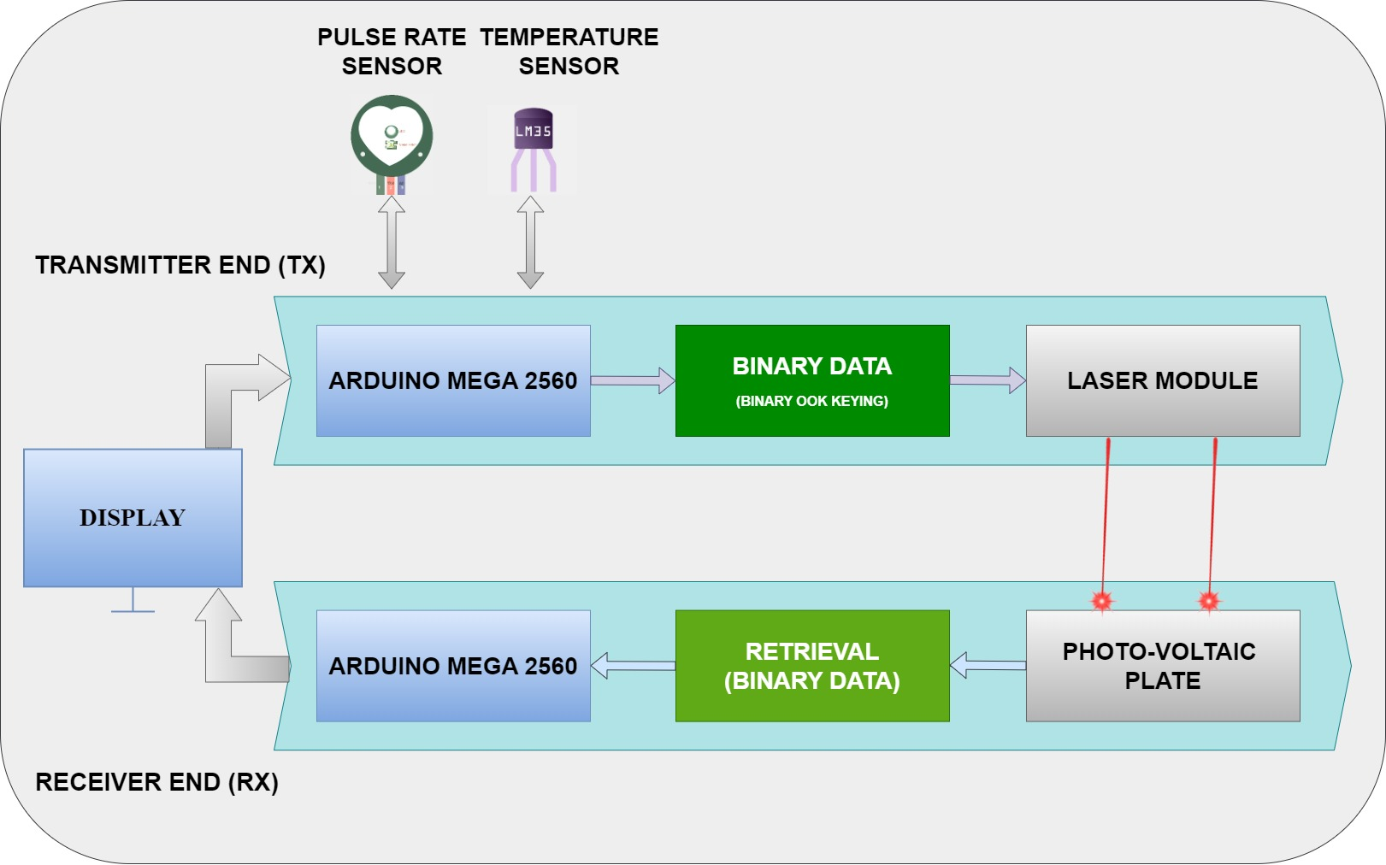

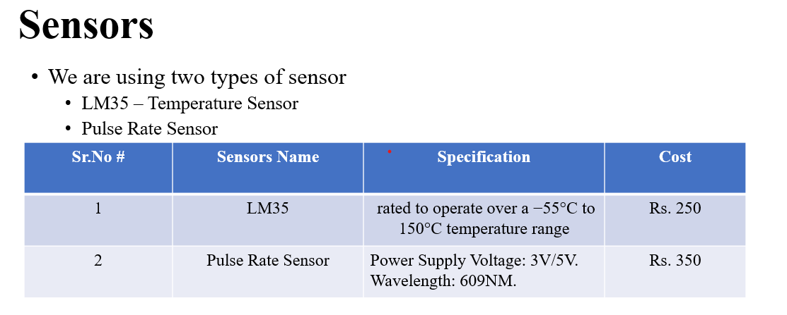
BLOCK DIAGRAM(SISO & MIMO)
MIMO
SISO
SENSORS

Slide 7
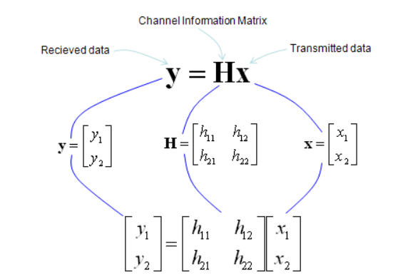
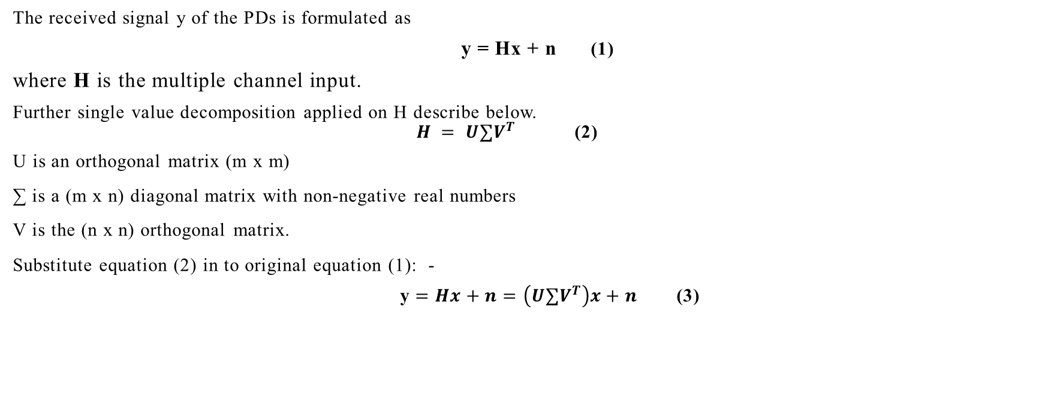
Mathematical Modeling
The received signal y of the PDs is formulated as
y = Hx + n (1)
where H is the multiple channel input.
Further single value decomposition applied on H describe below.
$H = U∑V^{T}$ (2)
U is an orthogonal matrix (m x m)
∑ is a (m x n) diagonal matrix with non-negative real numbers
V is the (n x n) orthogonal matrix.
Substitute equation (2) in to original equation (1): -
y $=Hx+n=\left(U∑V^{T}\right)x+n$ (3)
that decomposes a matrix into three simpler matrices
It is used to analyze and simplify matrices

Slide 8
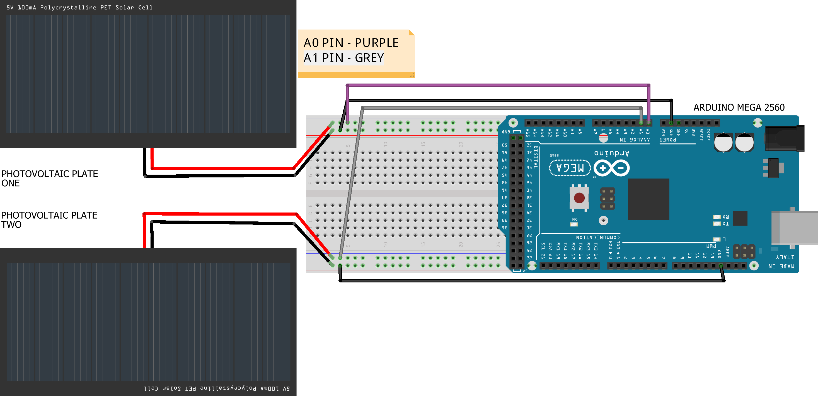
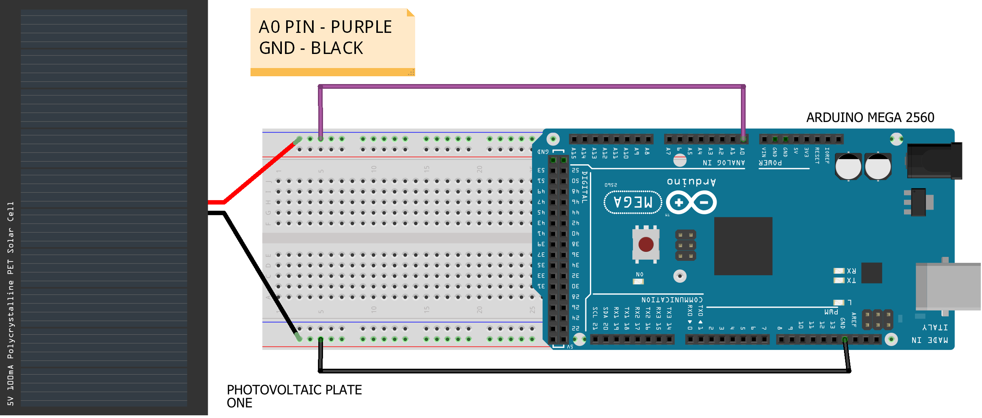
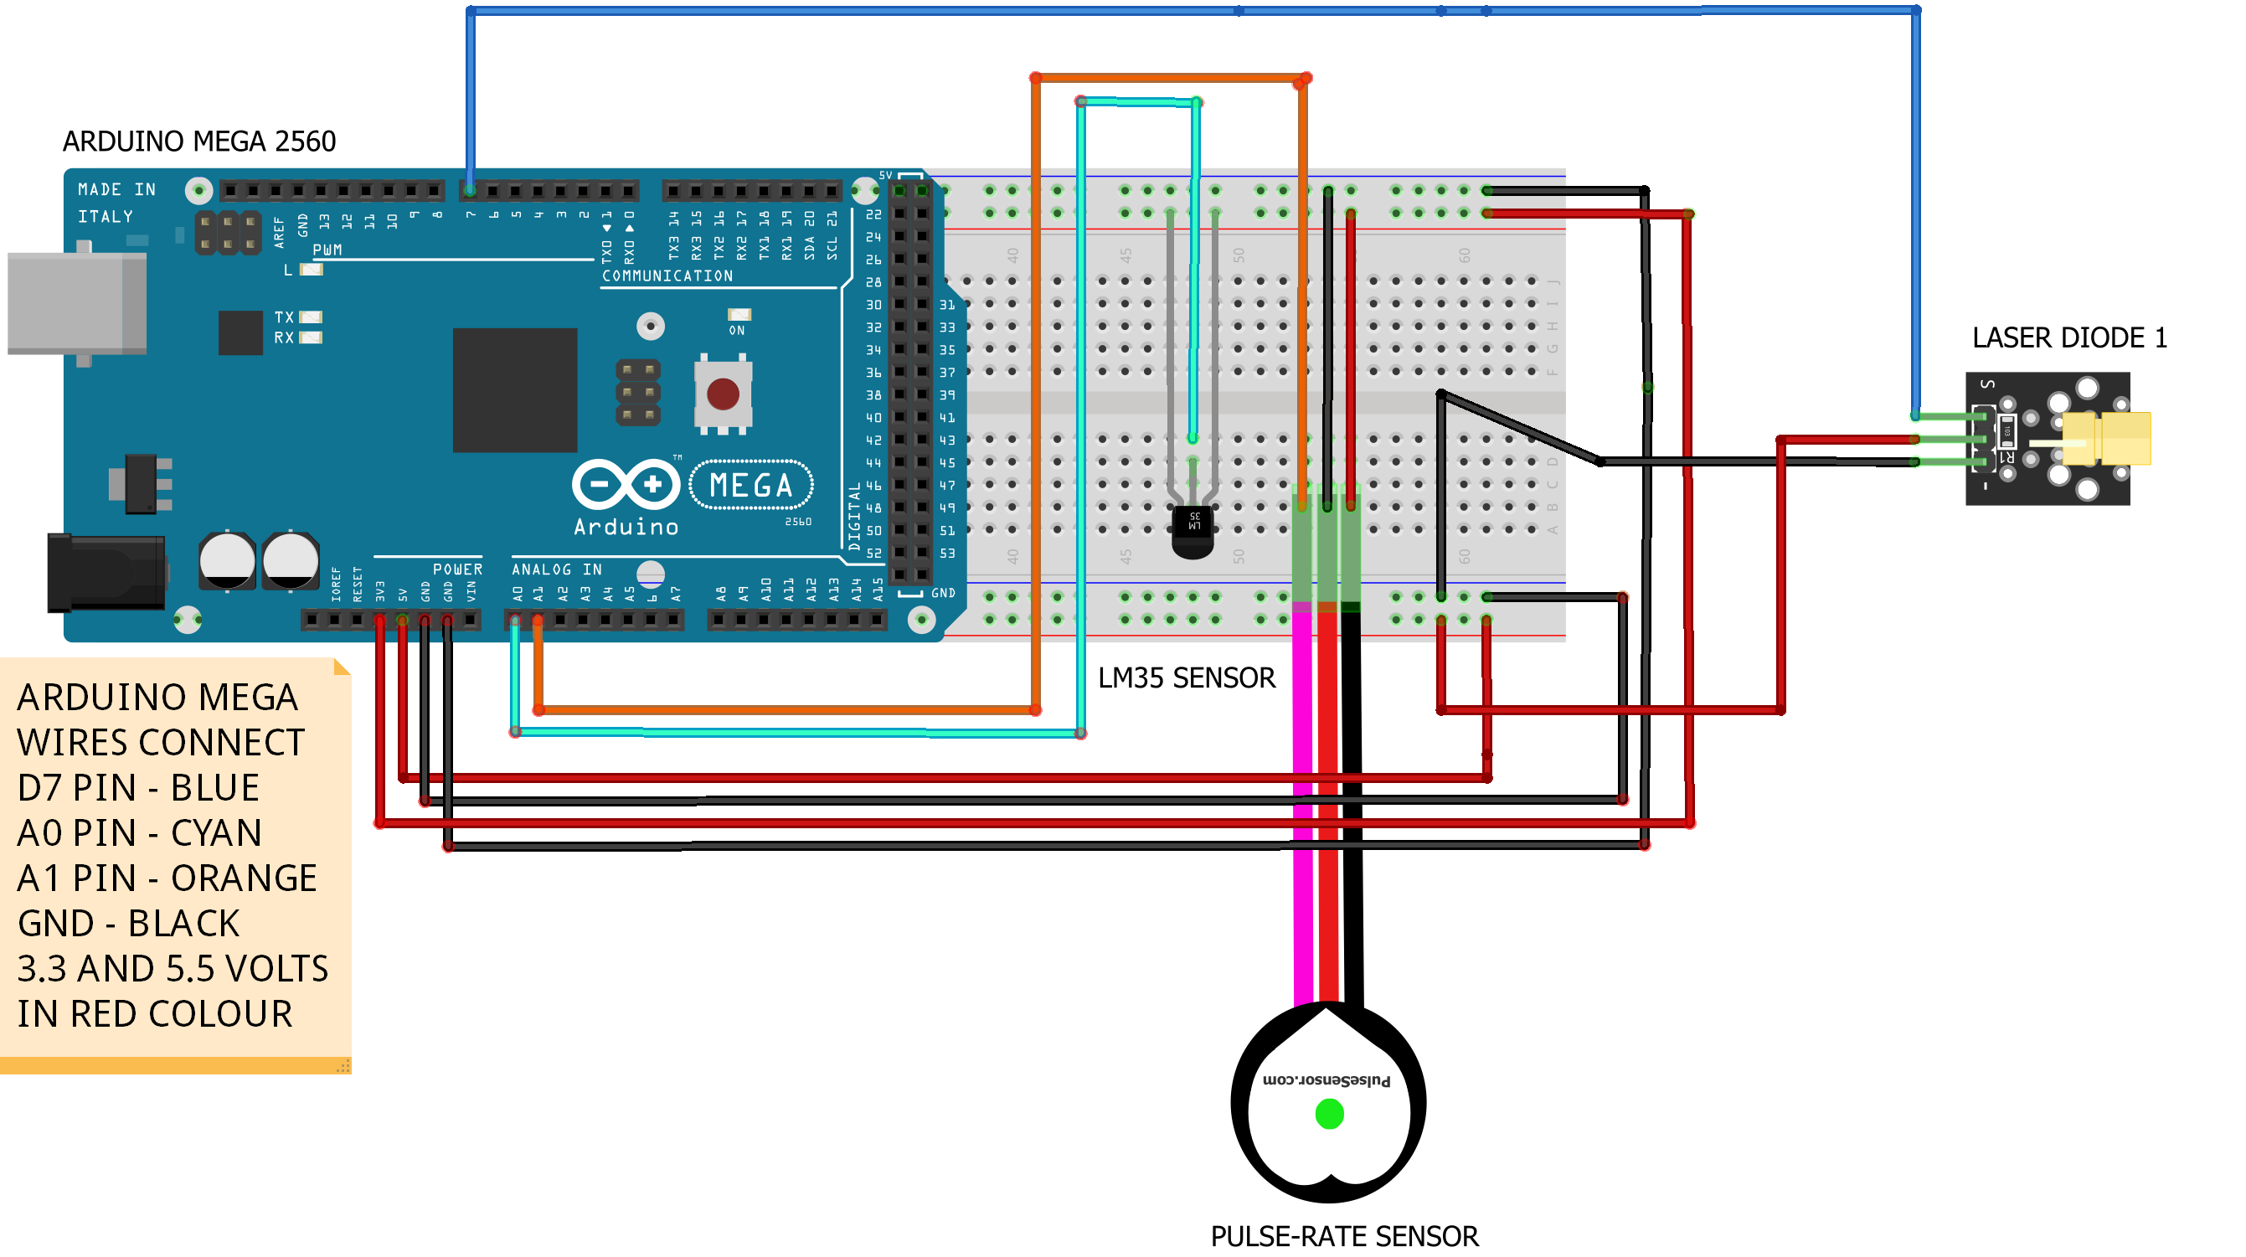
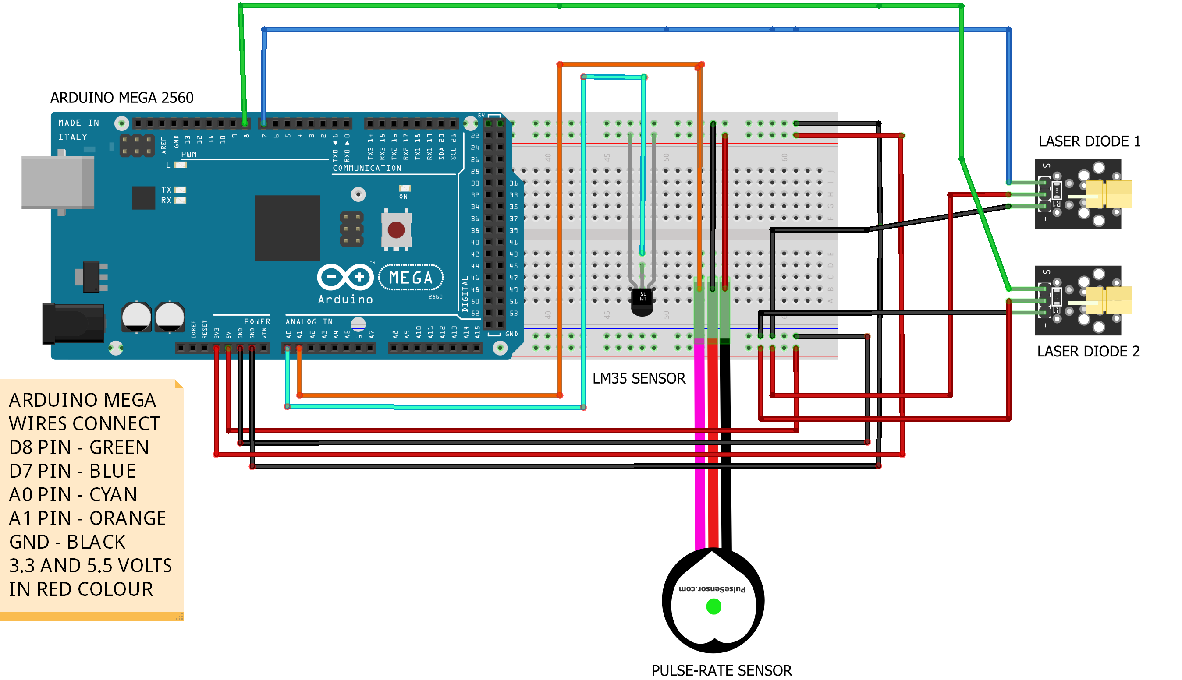
Hardware diagram (tx & rx)
MIMO TX END
SISO RX END
MIMO RX END
SISO TX END

Slide 9
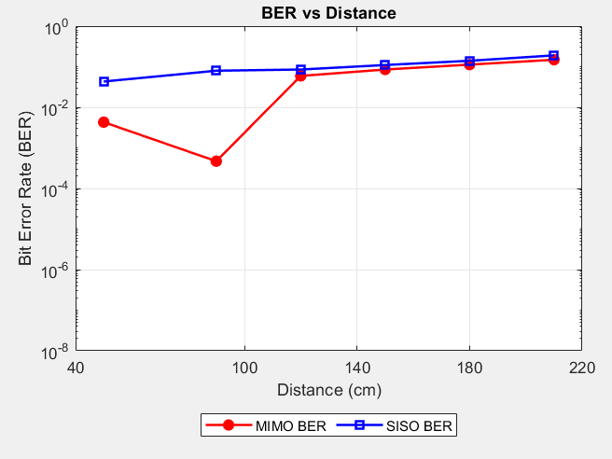
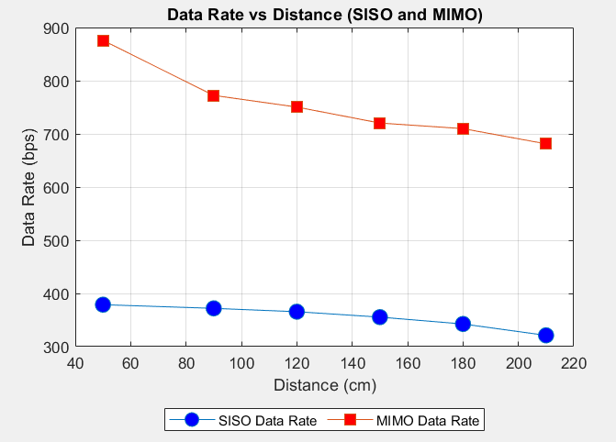
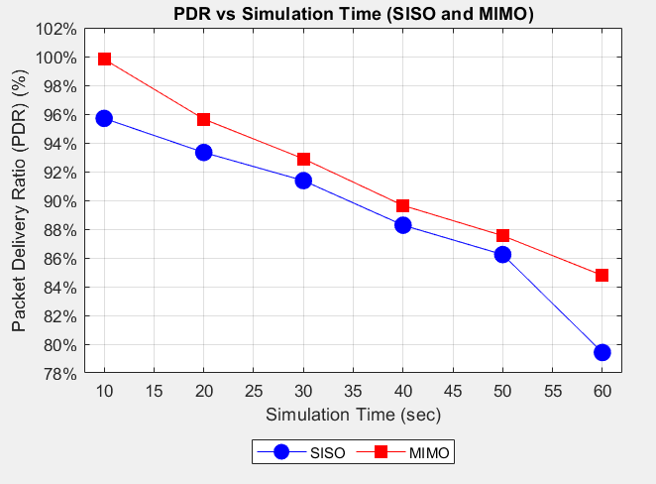
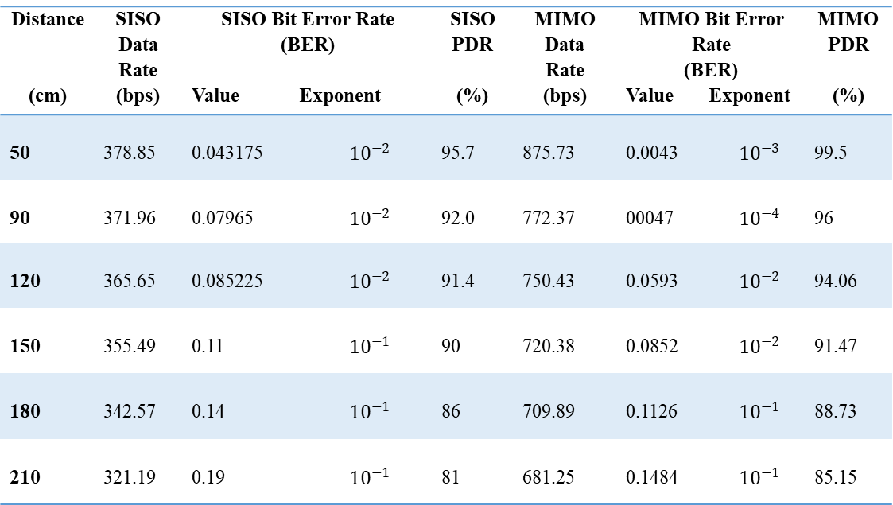
Performance Analysis
COMPARISON OF SISO AND MIMO RESULTS
SISO & MIMO - Data Rate Vs Distance Graph
SISO & MIMO - Bit Error Rate Vs Distance Graph
SISO & MIMO - PDR Vs Simulation Time Graph
Distance (cm) | SISO Data Rate (bps) | SISO Bit Error Rate (BER) Value Exponent |  | SISO PDR (%) | MIMO Data Rate (bps) | MIMO Bit Error Rate (BER) Value Exponent |  | MIMO PDR (%)
50 | 378.85 | 0.043175 | $${10}^{−2}$$ | 95.7 | 875.73 | 0.0043 | $${10}^{−3}$$ | 99.5
90 | 371.96 | 0.07965 | $${10}^{−2}$$ | 92.0 | 772.37 | 00047 | $${10}^{−4}$$ | 96
120 | 365.65 | 0.085225 | $${10}^{−2}$$ | 91.4 | 750.43 | 0.0593 | $${10}^{−2}$$ | 94.06
150 | 355.49 | 0.11 | $${10}^{−1}$$ | 90 | 720.38 | 0.0852 | $${10}^{−2}$$ | 91.47
180 | 342.57 | 0.14 | $${10}^{−1}$$ | 86 | 709.89 | 0.1126 | $${10}^{−1}$$ | 88.73
210 | 321.19 | 0.19 | $${10}^{−1}$$ | 81 | 681.25 | 0.1484 | $${10}^{−1}$$ | 85.15

Slide 10
CONCLUSION
Application of Project
FUTURE WORK
Remote Medical Camps
Telemedicine and Remote Consultations
Mobile Clinics
Fitness Centers and Gyms for Real-Time Health Tracking
Li-Fi Signal Processing Techniques
Employing advanced signal processing techniques to enhance signal quality, reduce latency, and improve overall network efficiency in hospital environments.
Li-Fi Security Mechanisms
Implementing robust encryption algorithms and security measures specific to Li-Fi technology to protect patient data and ensure privacy compliance.
Li-Fi-enabled IoT Devices
Integrating Li-Fi capabilities into IoT devices used in hospitals, enabling them to transmit and receive data rapidly and securely through light waves
Li-Fi technology significantly enhances data transfer rates in hospitals, ensuring rapid and reliable communication for critical applications.
Combining MIMO systems with SVD precoding optimizes packet delivery, reducing errors and improving network efficiency.
SVD precoding ensures robust data transmission by managing channel conditions, leading to reliable connectivity in hospital settings.
Advanced Li-Fi and SVD precoding support high-performance data transfer, improving patient care and streamlining hospital operations.

Slide 11

Benefit to Society
UN Sustainable Goals
Improved data security
Faster data transfer rates
Energy-efficient data transmission
More reliable connectivity
Not very costly
Good Health and Well-Being
Improved Healthcare Access

Slide 12
Thank You All For Listening

